Slide 1
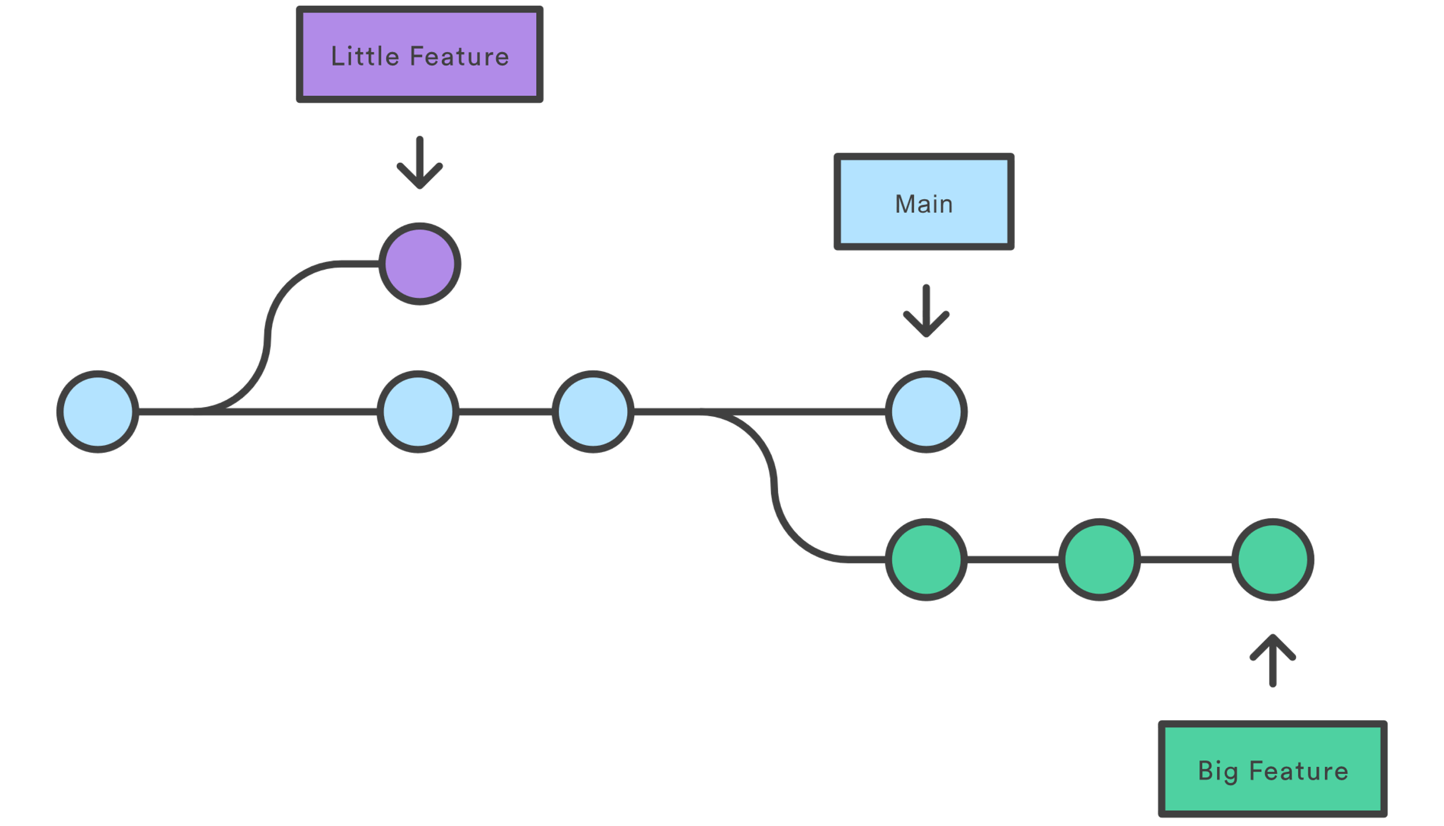
Git Branch
branch represents an independent line of development

Slide 2
Common Options
git branch list all of the branches
git branch <branch name> create a new branch called <..>
git checkout <branch name> switch to that branch
git checkout –b <branch name> is shorthand for steps 2+3
……..
git add …………. add files
git commit ………… commit changes
git checkout master switch to that branch
git merge <branch name> merge <branch name> into master
git branch –d <branch name> delete branch <branch name>
https://git-scm.com/book/en/v2/Git-Branching-Basic-Branching-and-Merging
https://www.atlassian.com/git/tutorials/using-branches

